Slide 1
Expressive Human and Command Languages
Ying shen
School of software engineering
Tongji university

Slide 2
Outline
Introduction
Speech recognition
Speech production
Human language technology
Traditional command languages

Slide 3
Outline
Introduction
Speech recognition
Speech production
Human language technology
Traditional command languages

Slide 4
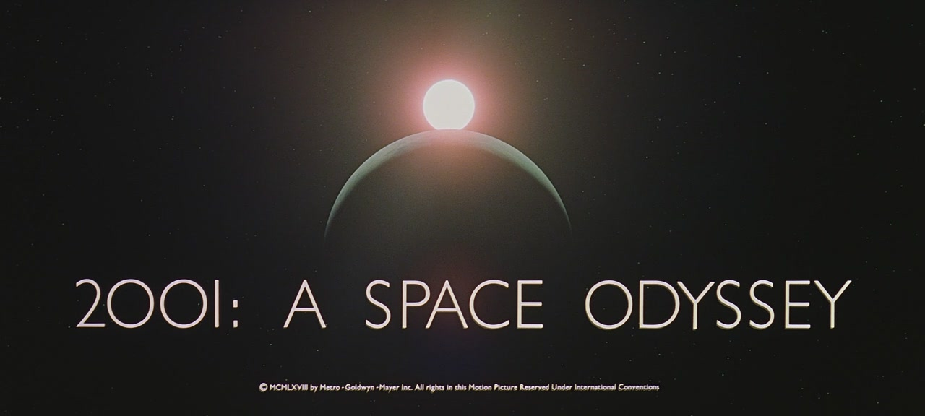
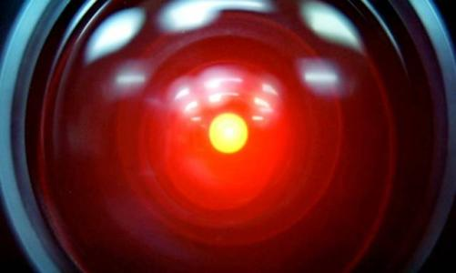
Introduction
The dream of speaking to computers and having computers speak has long lured researchers and visionaries
The reality is more complex than science fiction movies, but now speech recognition technique has been much improved
  Balance between recognition errors and error correction
Besides speech recognition, human language technologies are needed to execute the appropriate action, initiate clarifying dialogue, or provide translations
Notes:
HAL9000
流浪地球MOSS
https://www.bilibili.com/video/BV1df4y1v71h/
https://www.bilibili.com/video/BV168411p7L8/

Slide 5
Introduction
Some applications simulate natural language interaction
Speech Technologies
  Store and replay (museum guides)
  Dictation (document preparation, web search)
  Close captioning, transcription
  Transactions over the phone
  Personal “assistant” (common tasks on mobile devices)
  Hands-free interaction with a device
  Adaptive technology for users with disabilities
  Translation
  Alerts
  Speaker identification
Notes:
https://www.bilibili.com/video/BV1qo4y1k7gm/?spm_id_from=333.788.recommend_more_video.6&vd_source=fe7e2791b2ba227b865b62c98e517715
https://www.microsoft.com/en-us/research/product/soundscape/features/
农行电话.m4a
人工智能实时解说足球比赛.mp4

Slide 6
Outline
Introduction
Speech recognition
Speech production
Human language technology
Traditional command languages

Slide 7
Speech recognition
Speech recognition has made significant progress in recent years
  Airline information, lost luggage, medical-record data entry, personal digital assistants
Driven by the difficulty of typing while using mobile devices, spoken input has gained acceptability
To avoid recognition errors, most applications require users to learn complex sets of commands
Background noise and variations in user speech performance make the challenge of speech recognition

Slide 8
Classification of speech recognition system
Users
  Speaker dependent system
  Speaker independent system
  Speaker adaptive system
Vocabulary
  small vocabulary : tens of word
  medium vocabulary : hundreds of words
  large vocabulary : thousands of words
  very-large vocabulary : tens of thousands of words
Word pattern
  isolated-word system : single words at a time
  continuous speech system : words are connected together

Slide 9
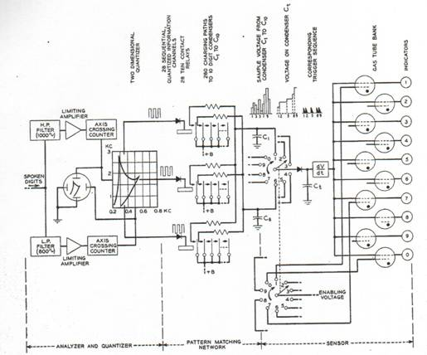
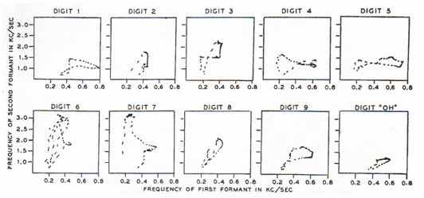
History of ASR
1952 – Automatic Digit Recognition (AUDREY)
  Davis, Biddulph, Balashek (Bell Laboratories)
Notes:
The first serious speech recognizer was developed in 1952 by Davis, Biddulph, and Balashek of Bell Labs. Analog circuit using filters, amplifiers and integrators. Using a simple frequency splitter, it generated plots of the first two formants, which it identified by matching them against prestored patterns in an analog memory. With training, it was reported, the machine achieved 97 percent accuracy on the spoken forms of ten digits.
Thus an utterance of an unknown digit could be recognized if its pattern on the formant-one/formant-two plane was compared with those of all digits plotted during the experimental phase. That was the principle on which Audrey was based. Rather than comparing the whole patterns point by point, twenty numbers were computed and stored for each digit, characterizing the corresponding average pattern on the formant-one/formant-two plane. Those twenty characteristic numbers were then computed, in the same way, for any incoming utterance to be recognized, and compared with the stored sets. The digit with the stored set of twenty numbers more similar to the newly computed one was the digit that most probably was uttered. Speaker dependent.
(wiki) In 1952 three Bell Labs researchers built a system for single-speaker digit recognition. Their system worked by locating the formants in the power spectrum of each utterance.^{[7]} The 1950s era technology was limited to single-speaker systems with vocabularies of around ten words.

Slide 10
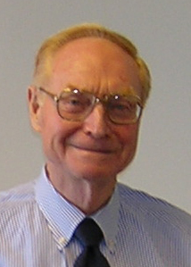
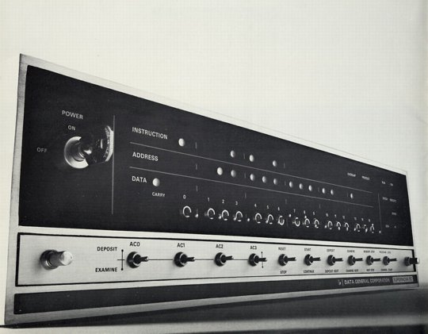
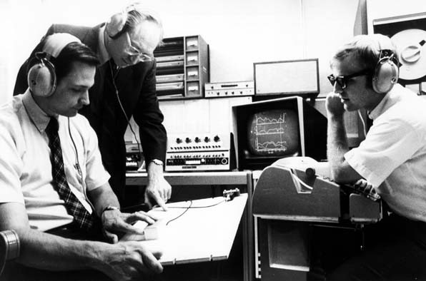
History of ASR
1960’s – Speech Processing and Digital Computers
AD/DA converters and digital computers start appearing in the labs
James Flanagan
Bell Laboratories
Notes:
Flanagan joined Bell Labs in 1957. Although there was already some work done in speech processing it was mostly using analog circuits. Jim helped to introduce AD/DA and start pioneering new research in speech processing using computers. Much easier, more flexible and cheaper than building electric circuits. Much larger experiments possible altho not in real time for quite a while.

Slide 11
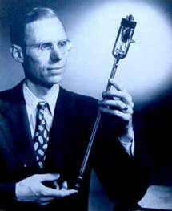
History of ASR
1969 – Whither Speech Recognition?
General purpose speech recognition seems far away. Social-purpose speech recognition is severely limited. It would seem appropriate for people to ask themselves why they are working in the field and what they can expect to accomplish…
It would be too simple to say that work in speech recognition is carried out simply because one can get money for it. That is a necessary but not sufficient condition. We are safe in asserting that speech recognition is attractive to money. The attraction is perhaps similar to the attraction of schemes for turning water into gasoline, extracting gold from the sea, curing cancer, or going to the moon. One doesn’t attract thoughtlessly given dollars by means of schemes for cutting the cost of soap by 10%. To sell suckers, one uses deceit and offers glamour…
Most recognizers behave, not like scientists, but like mad inventors or untrustworthy engineers. The typical recognizer gets it into his head that he can solve “the problem.” The basis for this is either individual inspiration (the “mad inventor” source of knowledge) or acceptance of untested rules, schemes, or information (the untrustworthy engineer approach).
The Journal of the Acoustical Society of America, June 1969
J. R. Pierce
Executive Director,
Bell Laboratories
Notes:
(wiki) Unfortunately, funding at Bell Labs dried up for several years when, in 1969, the influential John Pierce wrote an open letter that was critical of speech recognition research.^{[8]} Pierce defunded speech recognition research at Bell Labs where no research on speech recognition was done until Pierce retired and James L. Flanagan took over.
Every technology has its own negative people. Never believed. He was right that he never saw good performance.

Slide 12
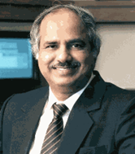
History of ASR
1971-1976: The ARPA SUR project
Despite anti-speech recognition campaign led by Pierce Commission ARPA launches 5 year Spoken Understanding Research program
Goal: 1000-word vocabulary, 90% understanding rate, near real time on 100 mips machine
4 Systems built by the end of the program
  SDC (24%)
  BBN’s HWIM (44%)
  CMU’s Hearsay II (74%)
  CMU’s HARPY (95% -- but 80 times real time!)
Rule-based systems except for Harpy
  Engineering approach: search network of all the possible utterances
Raj Reddy -- CMU
Notes:
the objective of ASR is, properly, speech understanding, not simply correct identification of words in a spoken message. Systems, therefore, should be evaluated in terms of their ability to respond correctly to spoken messages about such pragmatic problems as travel budget management. Limited domain, somewhat speaker tuned, quiet room. The objective goal of ARPA SUR was a recognition system with 90 percent sentence accuracy for continuous-speech sentences, using thousand-word vocabularies, not in real time. Of four principal ARPA SUR projects, the only one to meet the stated goal was Carnegie Mellon University's Harpy system, which achieved a 5 percent error rate on a 1,011-word vocabulary on continuous speech. One of the ways the CMU team achieved the goal was clever: they made the task easier by restricting word order; that is, by limiting spoken words to certain sequences in the sentence.
(wiki) Raj Reddy was the first person to take on continuous speech recognition as a graduate student at Stanford University in the late 1960s. Previous systems required the users to make a pause after each word. Reddy's system was designed to issue spoken commands for the game of chess.

Slide 13
History of ASR
1971-1976: The ARPA SUR project
Lack of clear evaluation criteria
  ARPA felt systems had failed
  Project not extended
Speech Understanding: too early for its time
Need a standard evaluation method

Slide 14
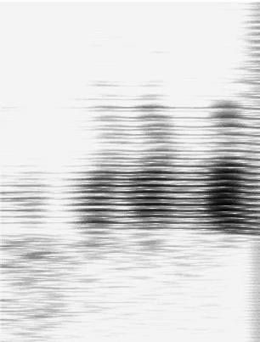
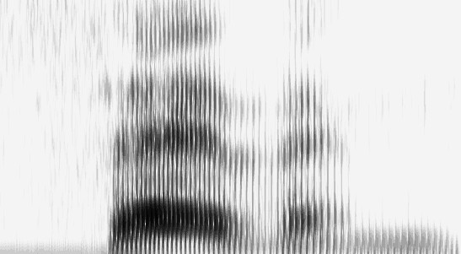
History of ASR
1970’s – Dynamic Time Warping
  The Brute Force of the Engineering Approach
T.K. Vyntsyuk (1968)
H. Sakoe,
S. Chiba (1970)
TEMPLATE (WORD 7)
Isolated Words
Speaker Dependent
Connected Words
Speaker Independent
Sub-Word Units
UNKNOWN WORD
Notes:
Compare input to word templates. What features discriminate between one word and another? Spectrograms? Divided into frames? With avg intensity computed over that frame. Word is seven.
Compute the least cost path of best matches of feature vectors between unknown word and templates, using dynamic programming. Recognizing one word could take seconds to hours, depending on vocabulary size and word length. Isolated word recognition.
(wiki) Also around this time Soviet researchers invented the dynamic time warping (DTW) algorithm and used it to create a recognizer capable of operating on a 200-word vocabulary.^{[9]} The DTW algorithm processed the speech signal by dividing it into short frames, e.g. 10ms segments, and processing each frame as a single unit. Although DTW would be superseded by later algorithms, the technique of dividing the signal into frames would carry on. Achieving speaker independence was a major unsolved goal of researchers during this time period.

Slide 15
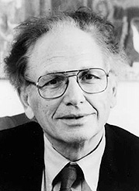
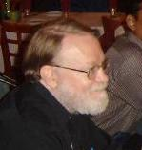
History of ASR
1980s -- The Statistical Approach
Based on work on Hidden Markov Models done by Leonard Baum at IDA, Princeton in the late 1960s
Purely statistical approach pursued by Fred Jelinek and Jim Baker, IBM T.J.Watson Research
Foundations of modern speech recognition engines
Fred Jelinek
Acoustic HMMs
Word Tri-grams
a11
a22
a33
Jim Baker
a12
a23
S1
S2
S3
Notes:
Harpy represented all possible sentences as a finite state machine with 15K nodes of acoustic templates. Problem of finding best path thru network much like finding best path comparing word templates. Again, dynamic programming. IBM added probabilities to the mix, estimating statistical models of phonemes automatically from data. Performance went from 35% with hand-estimated models to 75%.

Slide 16
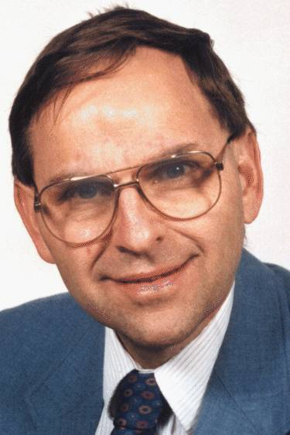
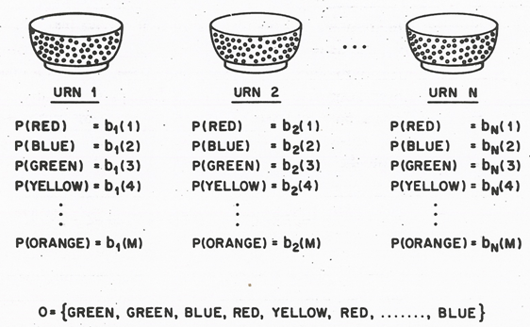
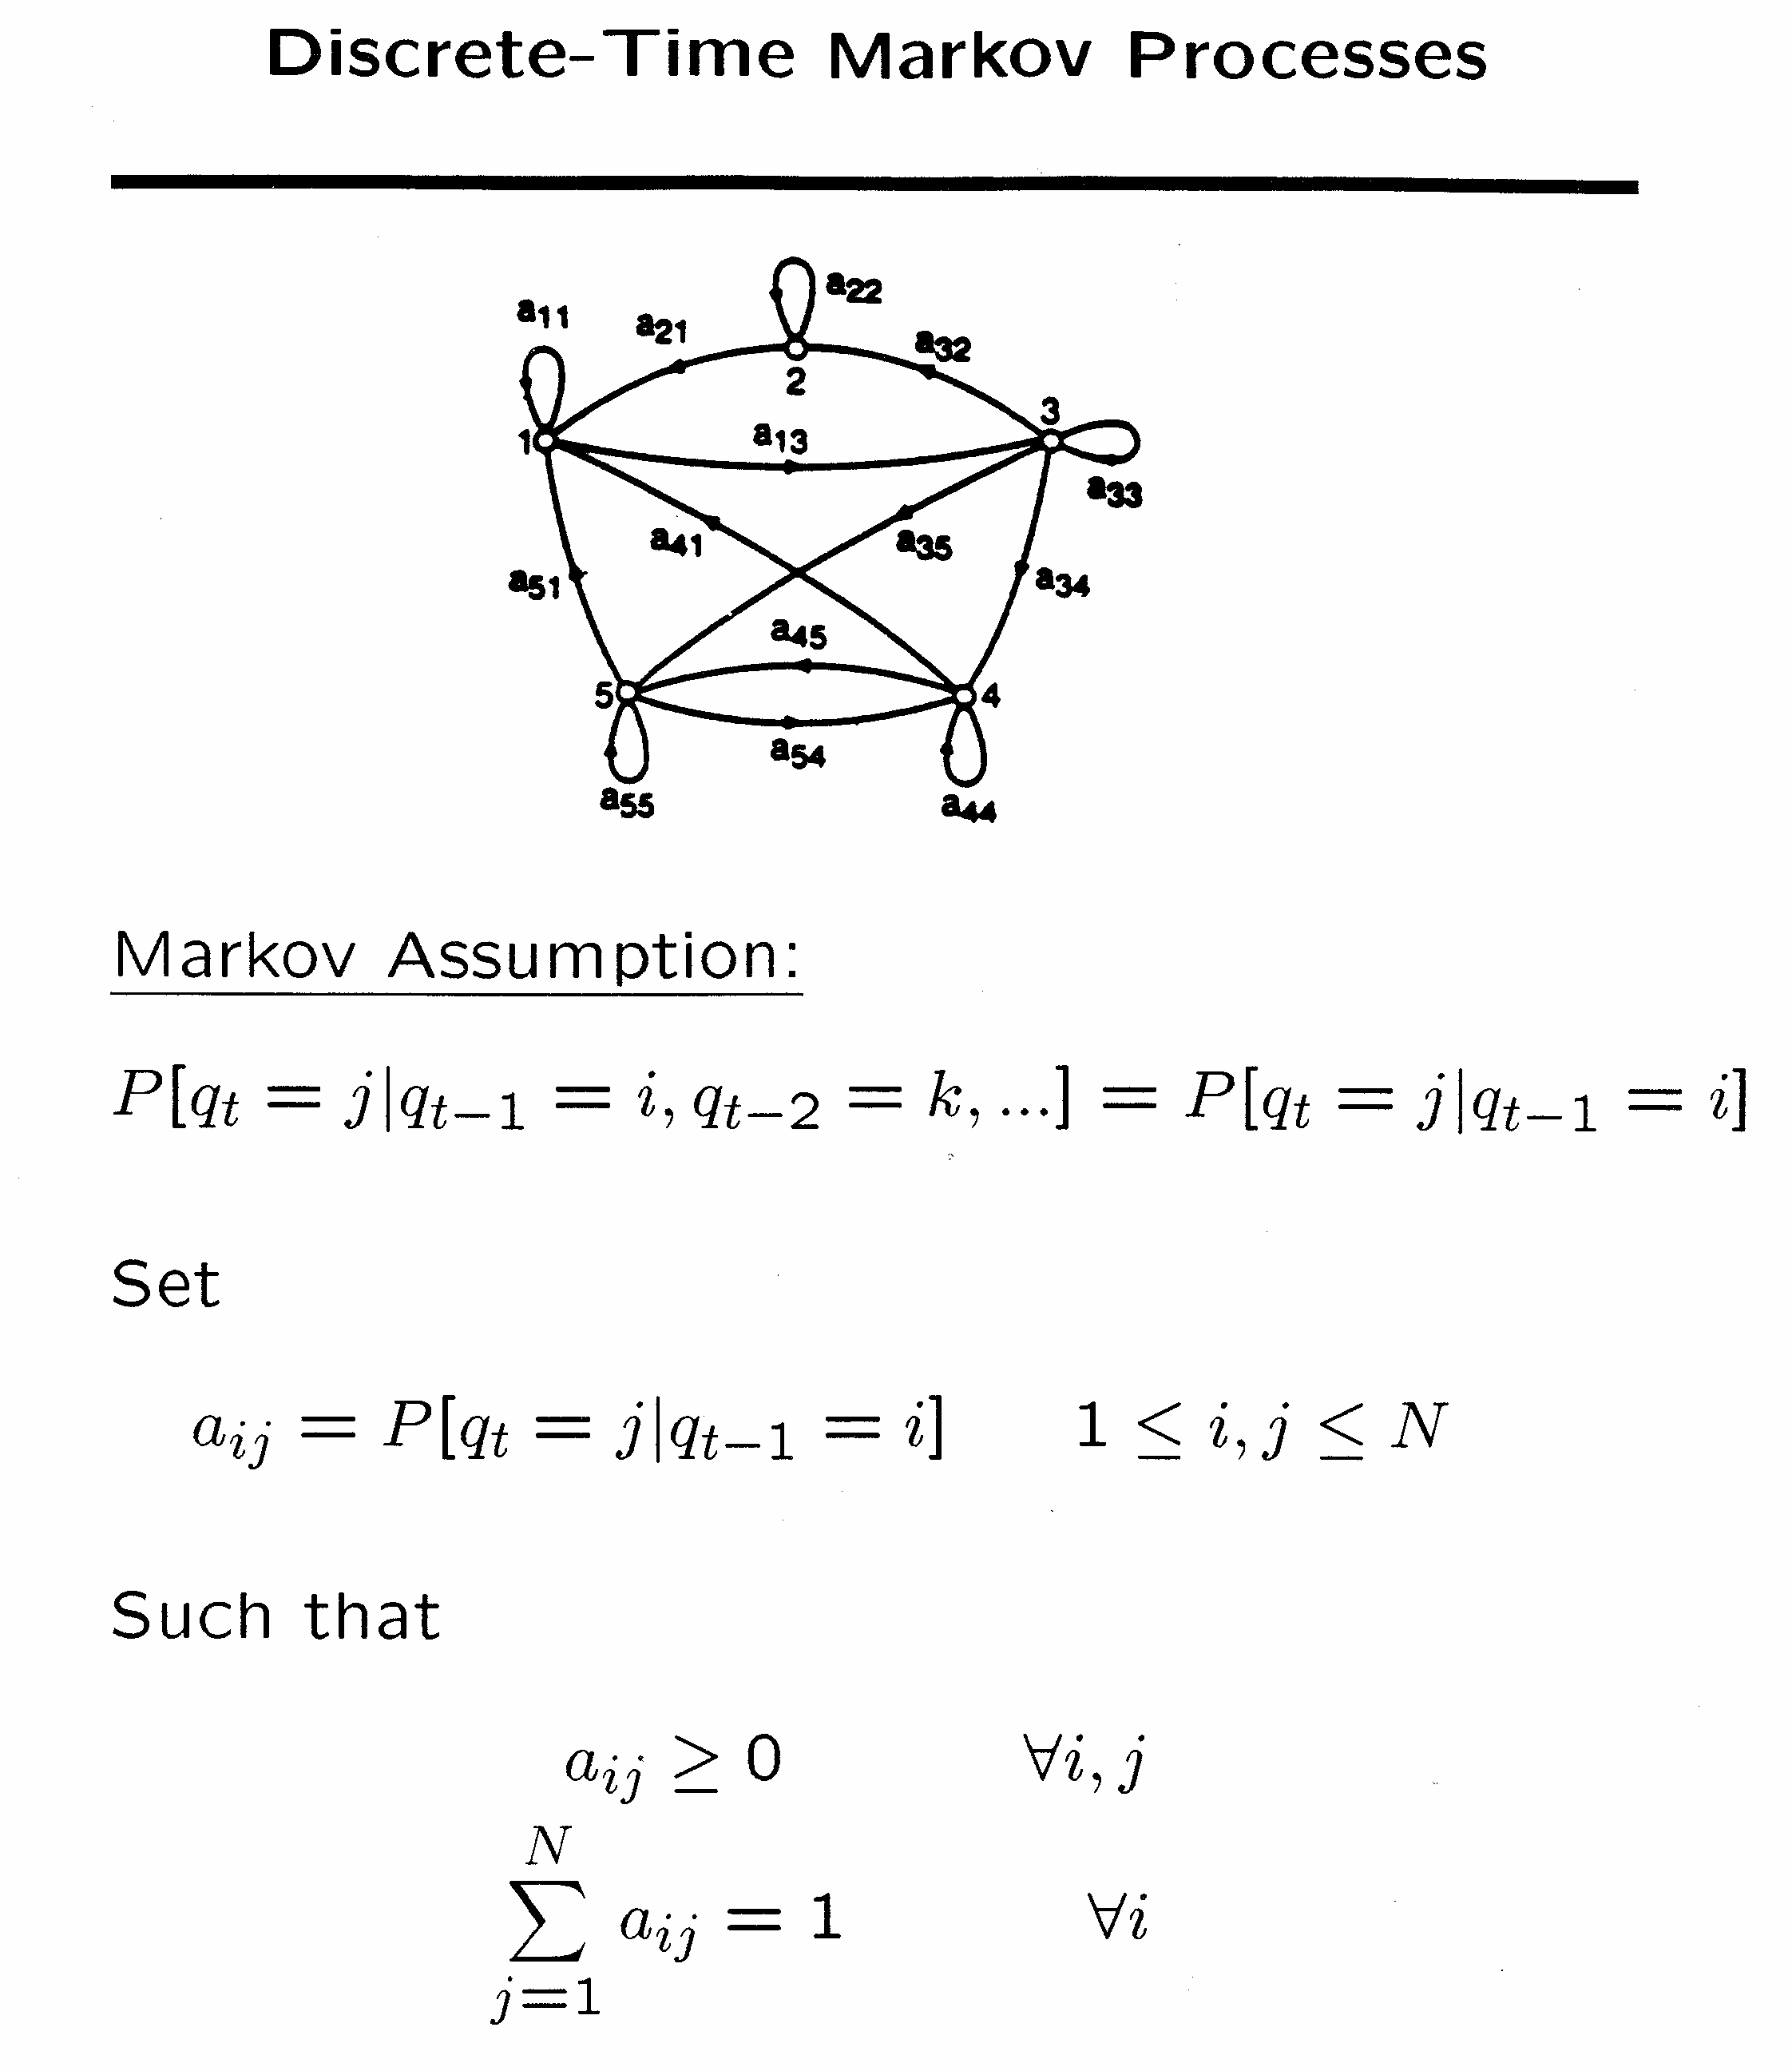
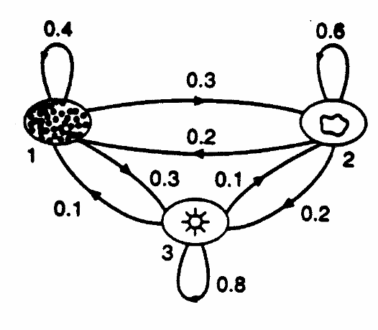
History of ASR
1980-1990 – Statistical approach becomes ubiquitous
Lawrence Rabiner, A Tutorial on Hidden Markov Models and Selected Applications in Speech Recognition, Proceeding of the IEEE, Vol. 77, No. 2, February 1989.
Notes:
HMMs represent sequential constraints of language. Actual processes of the vocal tract in producing a particular phone are ‘hidden states’ – but we can observe their result in the acoustic signal.
从Baum提出相关数学推理，经过Labiner等人的研究，李开复最终实现了第一个基于隐马尔科夫模型的大词汇量语音识别系统Sphinx，他也凭借此发明获得1988 美国商业周刊最重要发明奖。此后严格来说语音识别技术并没有脱离HMM框架，可以说现在手机上的语音拨号就脱胎于李开复的语音识别系统。

Slide 17
History of ASR: 21st Century
Low noise conditions
Large vocabulary
  ~20,000-60,000 words or more…
Speaker independent (vs. speaker-dependent)
Continuous speech (vs isolated-word)
Multilingual, conversational
World’s best research systems:
  Human-human speech: 5.5% Word Error Rate (WER)
  Human-machine or monologue speech: ~3-5% WER
Notes:
In the early 2000s, speech recognition was still dominated by traditional approaches such as Hidden Markov Models combined with feedforward artificial neural networks.^{[29]} Today, however, many aspects of speech recognition have been taken over by a deep learning method called Long short-term memory (LSTM), a recurrent neural network published by Sepp Hochreiter & Jürgen Schmidhuber in 1997.^{[30]} LSTM RNNs avoid the vanishing gradient problem and can learn "Very Deep Learning" tasks^{[31]} that require memories of events that happened thousands of discrete time steps ago, which is important for speech. Around 2007, LSTM trained by Connectionist Temporal Classification (CTC)^{[32]} started to outperform traditional speech recognition in certain applications.^{[33]} In 2015, Google's speech recognition reportedly experienced a dramatic performance jump of 49% through CTC-trained LSTM, which is now available through Google Voice to all smartphone users.^{[34]}
The use of deep feedforward (non-recurrent) networks for acoustic modeling was introduced during later part of 2009 by Geoffrey Hinton and his students at University of Toronto and by Li Deng and colleagues at Microsoft Research, initially in the collaborative work between Microsoft and University of Toronto which was subsequently expanded to include IBM and Google (hence "The shared views of four research groups" subtitle in their 2012 review paper).^{[35][36][37]} A Microsoft research executive called this innovation "the most dramatic change in accuracy since 1979."^{[38]} In contrast to the steady incremental improvements of the past few decades, the application of deep learning decreased word error rate by 30%. This innovation was quickly adopted across the field. Researchers have begun to use deep learning techniques for language modeling as well.

Slide 18
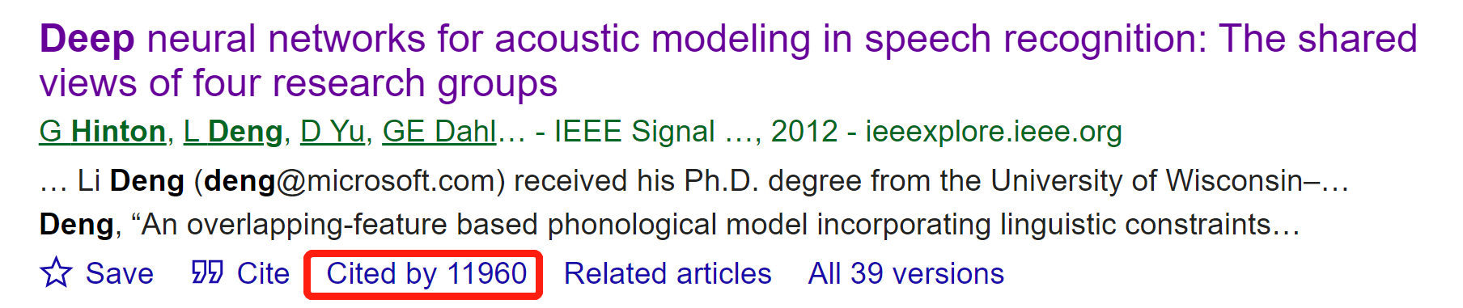
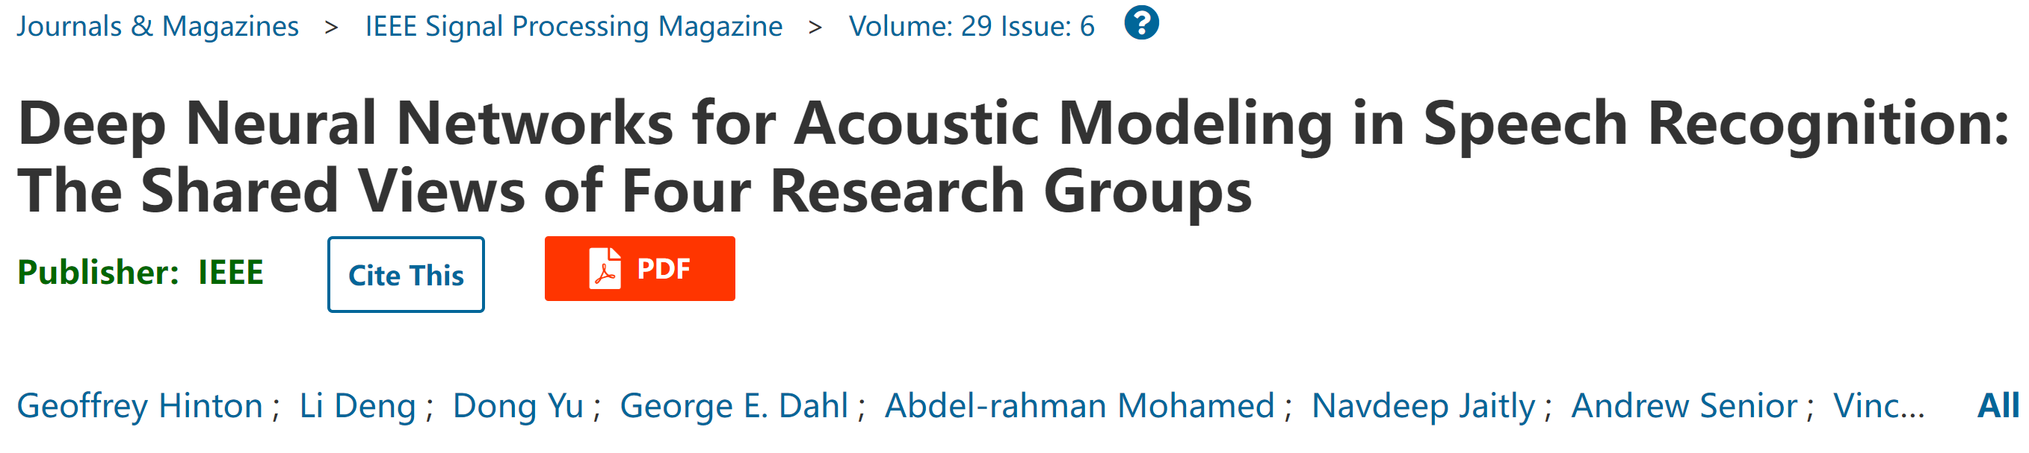
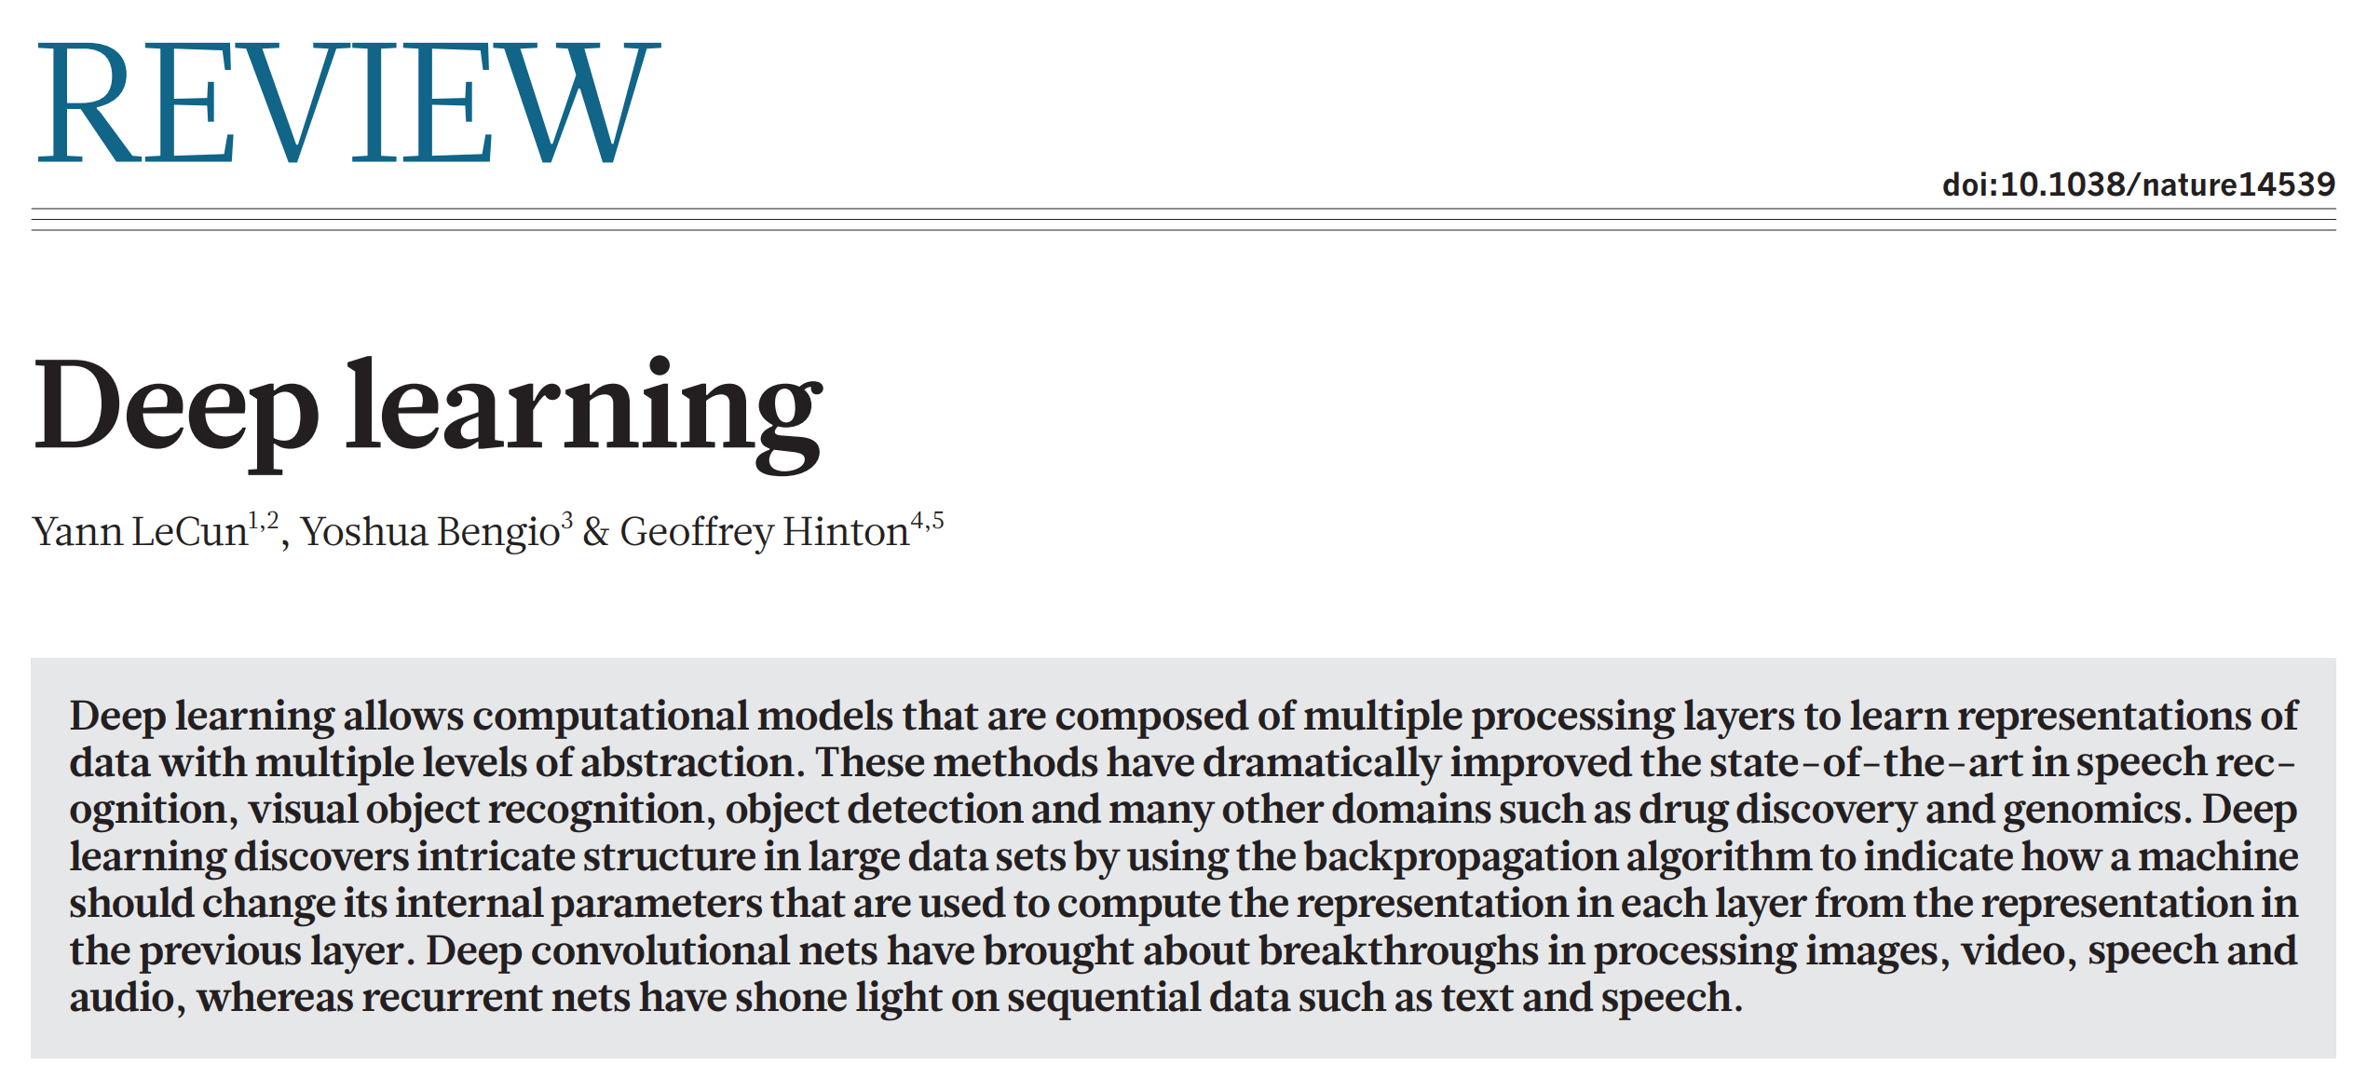
History of ASR: 21st Century

Slide 19
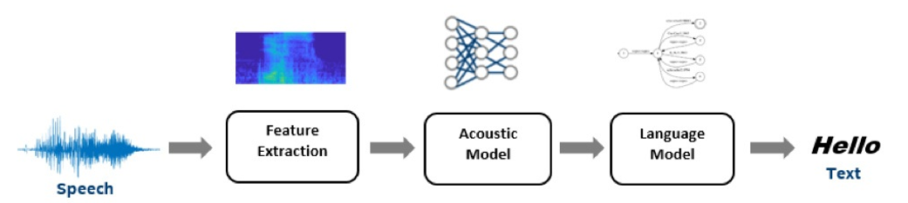
Traditional ASR architecture

Slide 20
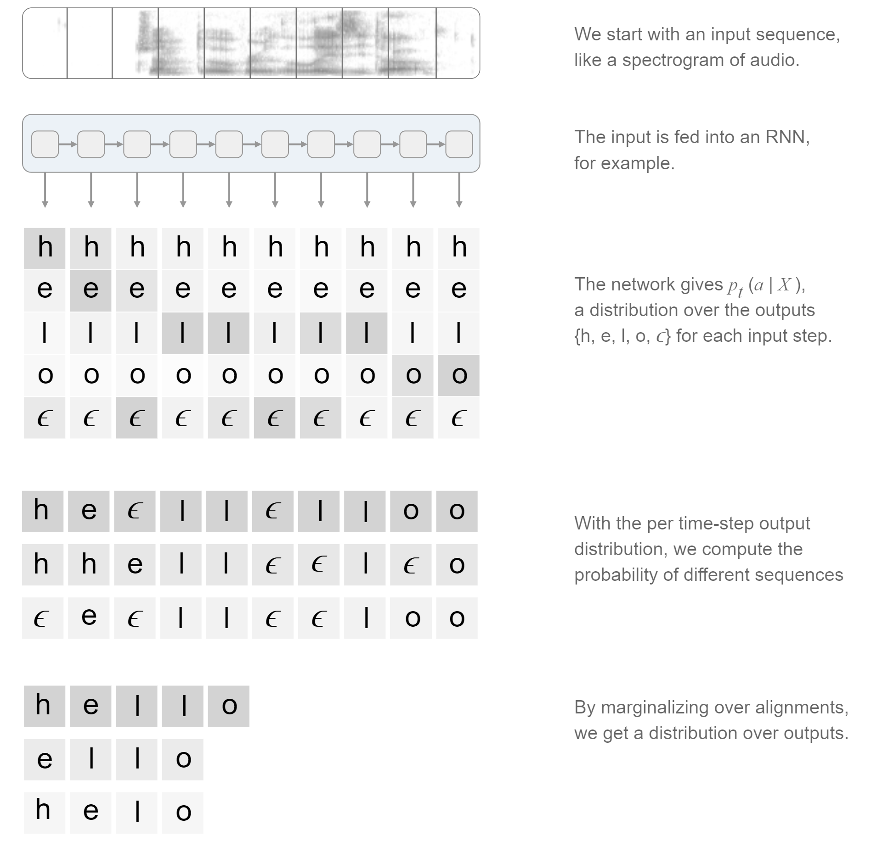
End-to-end ASR architecture

Slide 21
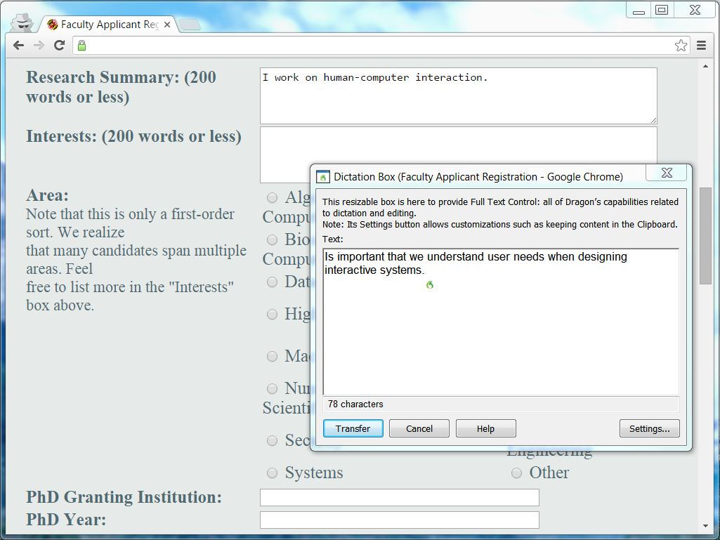
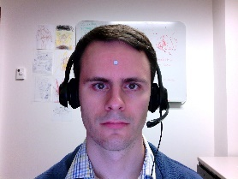
The place for spoken interaction
Opportunities of speech recognition and production
  When users have physical impairments
  When the speaker’s hands are busy
  When mobility is required
  When the speaker’s eyes are occupied
  When harsh or cramped conditions preclude use of a keyboard
  When application domain vocabulary and tasks are limited
  When the user is unable to read or write
Notes:
Using Nuance DragonTM speech dictation and a head mouse (as made visible by the little silver dot on his forehead), a computer scientist is able to overcome a temporary hand disability
(http://www.nuance.com/dragon/index.htm)

Slide 22

The place for spoken interaction
Obstacles for speech recognition
  Interference from noisy environments and poor-quality microphones
  Commands need to be learned and remembered
  Recognition may be challenged by strong accents or unusual vocabulary
  Talking is not always acceptable
  Error correction can be time-consuming
  Increased cognitive load compared with typing or pointing

Slide 23
The place for spoken interaction
Obstacles for speech production
  Slow pace of speech output when compared with visual displays
  Ephemeral nature of speech
  Not socially acceptable in public spaces
  Difficulty in scanning/searching spoken messages
Speaking is more demanding than many advocates of speech recognition report

Slide 24
Speech recognition applications
Speech recognition technologies have many variations, which can also be combined with speech production
Applications
  Dictation
  Transcribe audio materials
  Speak commands
  Specialized voice services
  Information voice response
  Translation
  Speaker verification
Original
Mixed
Separated
Notes:
人工智能实时解说足球比赛.mp4
https://mp.weixin.qq.com/s/ElEFJG_yDGvnqVgkC4Sc8Q

Slide 25
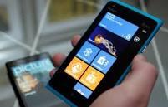
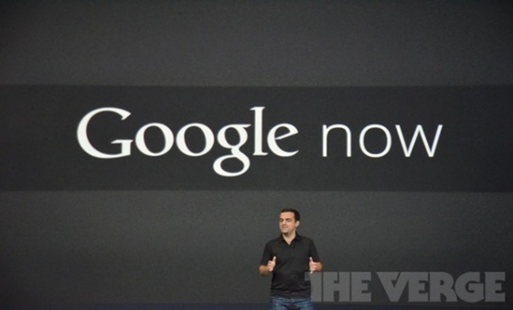
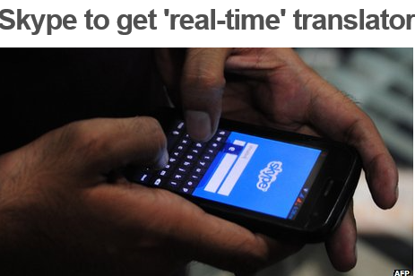
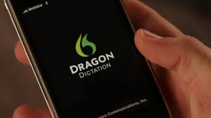
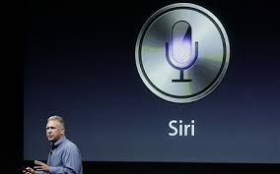
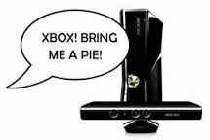
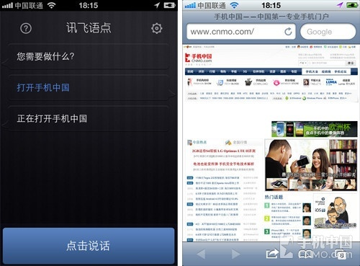
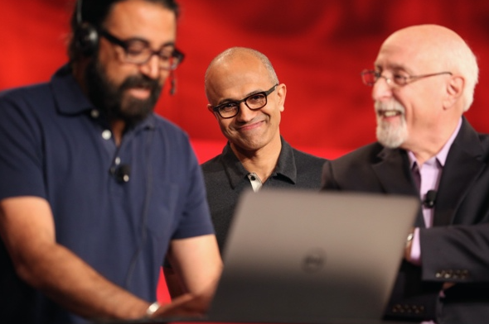
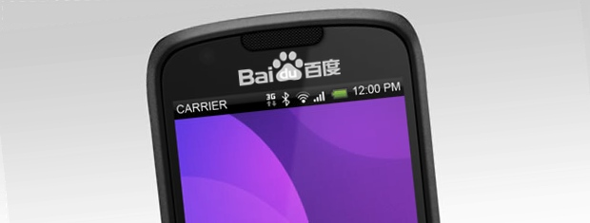
Speech recognition applications

Slide 26
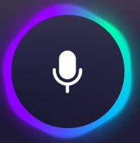
Designing spoken interaction
Prefer voice input + voice/visual output
  Allowing user to use a keyboard to correct errors is helpful
Initiation
  A start button
  A voice command, e.g. “Hey Siri” or “Wake up”
Knowing what to say
  For novice and intermittent users, make possible choices simple
  For repeat users, allow barge-in technique
Recognition errors
  Regional/foreign accents and background noise
  Users may stutter, misspeak, or use the wrong terms
  Unknown new words
  Robustness of speech recognition remains a major research change
Notes:
Knowing what to say: users need to know what can be said and reliably recognized.

Slide 27
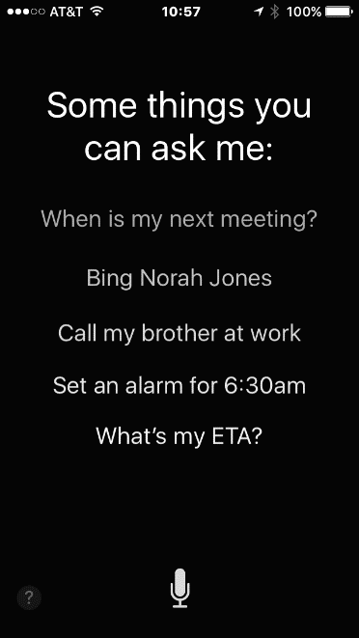
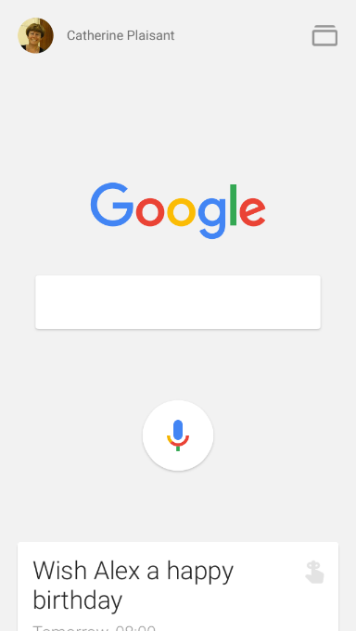
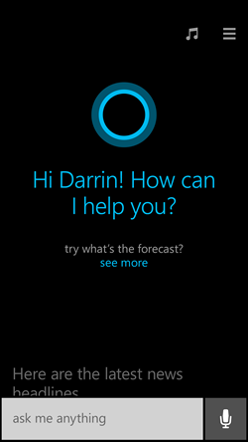
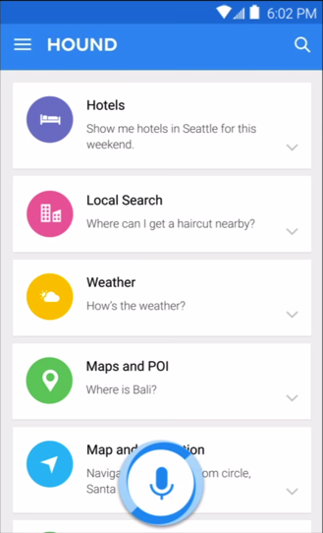
Designing spoken interaction
Mobile devices assistants (from left to right: Siri, GoogleNow, Cortana and Hound) all have similar microphone buttons, but different ways of presenting suggestions
Notes:
Users of mobile digital “assistants” are left with the burden of learning and remembering what the effective commands are. They may quickly become frustrated and quit if none of their attempts leads to success. Help can be provided with examples of commands, or users are left to search blog postings to find lists of effective prompts, but those lists may be very long and commands still have to be remembered.

Slide 28
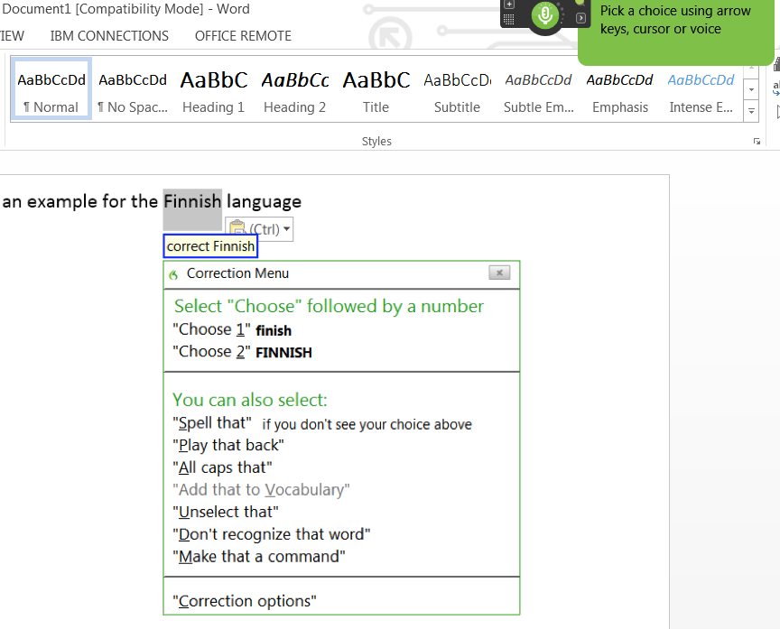
Designing spoken interaction
Correcting errors
  Very taxing
  Providing correction commands that are very distinct
Notes:
Correcting a word during dictation using Nuance DragonTM.
After saying “Correct finnish” the word is selected and possible corrections are displayed in a menu, along with additional commands such as “Spell that”
Users can use the cursor, arrow keys, or voice to specify their choice

Slide 29
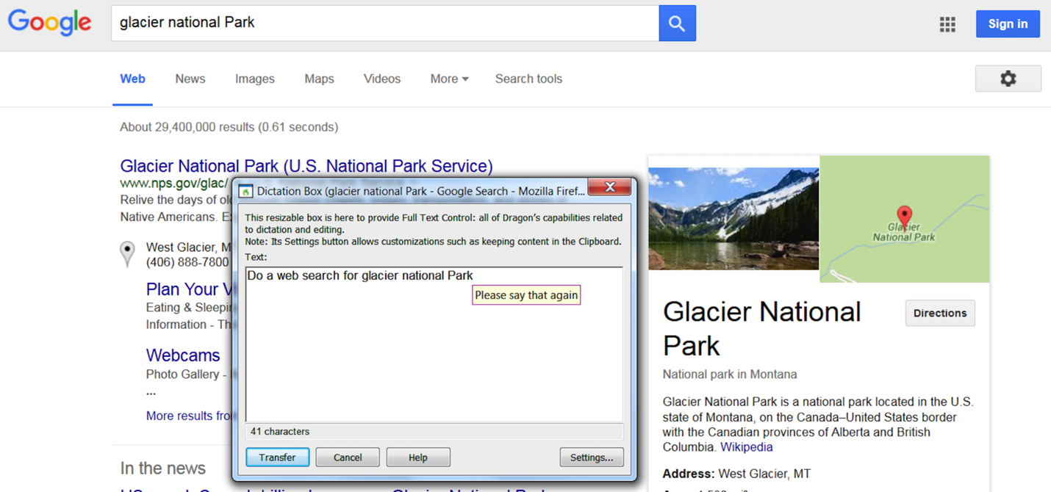
Designing spoken interaction
Mapping to possible actions
  Narrowing application domain can improve recognition accuracy
Notes:
The success of speech recognition applications is due to limited application domains, so the world of actions is limited. Banking IVRs only know about banking terms and have a small set of possible actions.
It can be difficult to remember what exact command will accomplish the task
In this example when the user said “Search the web for Glacier National Park” a Google search was launched and a search executed with the correct terms, but when the user said “Do a web search for Glacier National Park” the text was indeed accurately recognized but not as a command, so the text was placed in the Nuance DragonTM dictation box

Slide 30
Designing spoken interaction
Feedback and dialogs
  During diction or transcription, the recognized text is shown in the document being composed or in a dictation buffer, usually after a short delay.
  Specific questions may be asked to fill the holes in the task model and its attributes, e.g. “Set an alarm” -> “Set an alarm for when today?”
Notes:
During diction or transcription, the recognized text is shown in the document being composed or in a dictation buffer, usually after a short delay.

Slide 31
Spoken prompts and commands
Designers design prompts and commands resembling natural languages
  Clear and easy to remember
  Reliably recognized by the system
Study the task domain
  Get a list of task actions and objects
  E.g. “set an appointment for tomorrow”
A typical form is “verb + noun”
  E.g. “launch Facebook” or “set an alarm for 7 a.m.”
Notes:
Human learning is greatly facilitated by meaningful structure. If a set of commands is well-designed, users will recognize its structure and easily encode it in their semantic-knowledge storage.

Slide 32
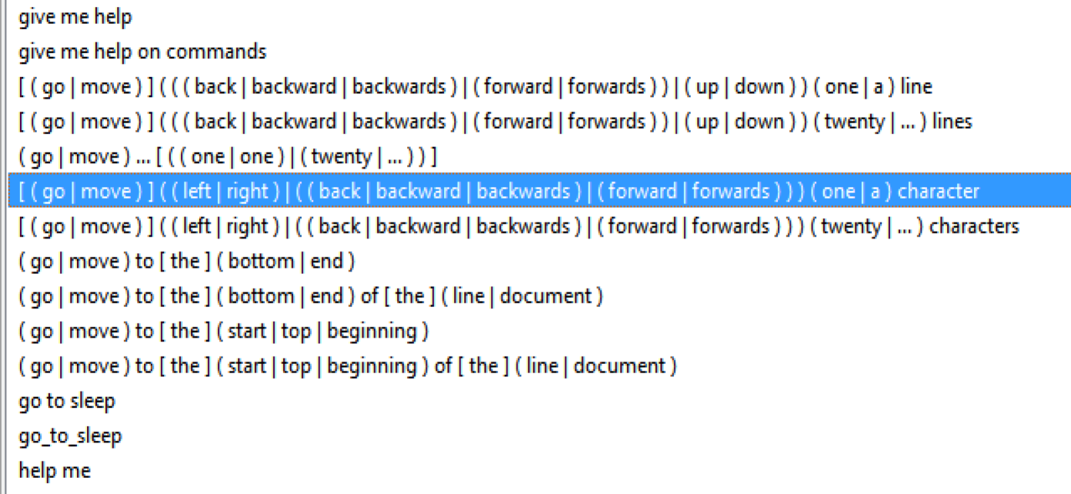
Spoken prompts and commands
A small subset of the rich set of commands used in the Nuance DragonTM speech recognition system
Synonyms are included and used consistently

Slide 33
Outline
Introduction
Speech recognition
Speech production
Human language technology
Traditional command languages

Slide 34
Speech production
Speech production is usually successful when
  the messages are simple and short; and users’ visual channels are overloaded
  Environment is too brightly lit, too poorly lit
There are three general methods to produce speech:
  Formant synthesis – machine-generated speech using algorithms
  Concatenated synthesis – uses tiny, recorded human speech segments
  Canned speech – fixed, digitized speech segments
Notes:
Canned speech: 公交车报站
（录音）

Slide 35
Speech production
Examples:
  Audio books or audio tours
  Instructional systems
  Online help systems
  Alerts and warnings
  Applications for the visually impaired
Notes:
https://www.ximalaya.com/album/55047919

Slide 36
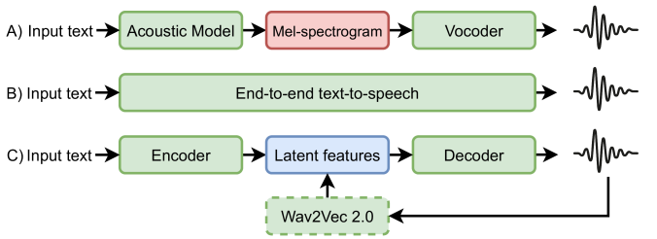
Speech production

Slide 37
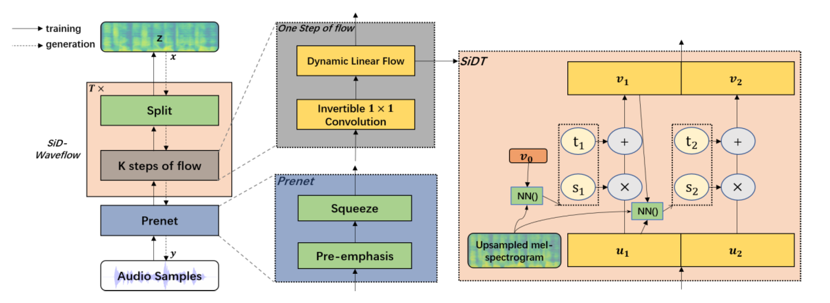
Speech production
Yuhan Li, Ying Shen*, Dongqing Wang and Lin Zhang, "SiD-WaveFlow: A Low-Resource Vocoder Independent of Prior Knowledge", in Proc. Interspeech 2022.

Slide 38
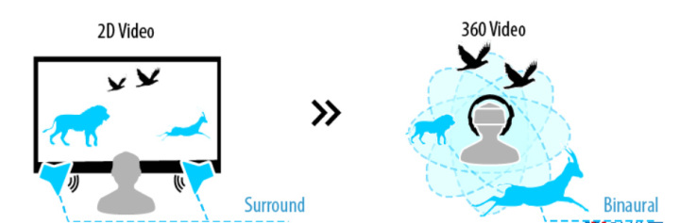
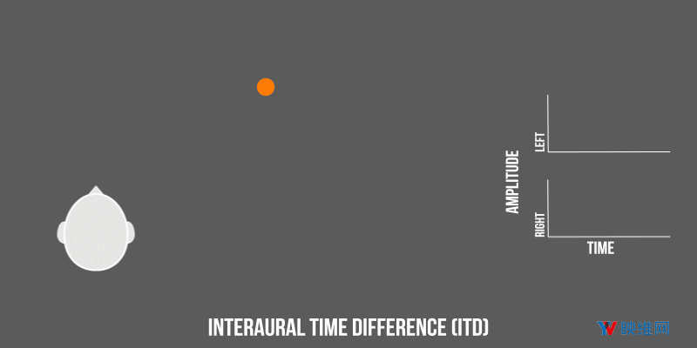
Binaural speech synthesis
Notes:
https://zhuanlan.zhihu.com/p/454755546?utm_source=wechat_session&utm_medium=social&s_r=0
双耳听觉.mp4

Slide 39
Outline
Introduction
Speech recognition
Speech production
Human language technology
Traditional command languages

Slide 40
Human language technology
Dream to design machines that understand natural language
Human-human interaction is not a good model for human operation of computers
  Computers display large amounts of information and users simply choose the items
Natural language interaction (NLI)
  Series of exchanges or “dialog” is difficult to design and build, on even a single topic
  Current successes often rely on statistical methods based on the analysis of vast textual or spoken data from millions of users
Notes:
Language is subtle; there are many special cases, contexts are complex, and emotional relationships have a powerful and pervasive effect in human-human communication.

Slide 41
Human language technology
Example applications and methods include:
  Question answering strategies
  Extraction and tagging, e.g. gathering data from a database of medical records
  Human language text generation
  Instructional systems
  Language translators, e.g. Google Translate

Slide 42
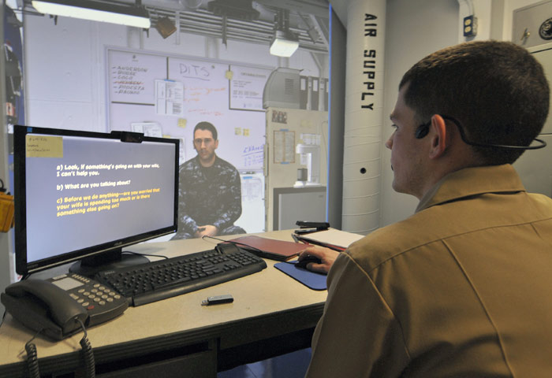
Human language technology
Using the Immersive Naval Officer Training System (INOTS) new navy officers can practice their counseling skills in a virtual reality environment
Officers listen to an avatar and respond using spoken language, loosely following suggestions from multi-choice prompts presented on the screen and designed to match the learning objectives
The interaction is constrained but assessment is facilitated
Notes:
(Dyke, 2013; www.netc.navy.mil/nstc/news_page_2012_02_24_2.asp)

Slide 43
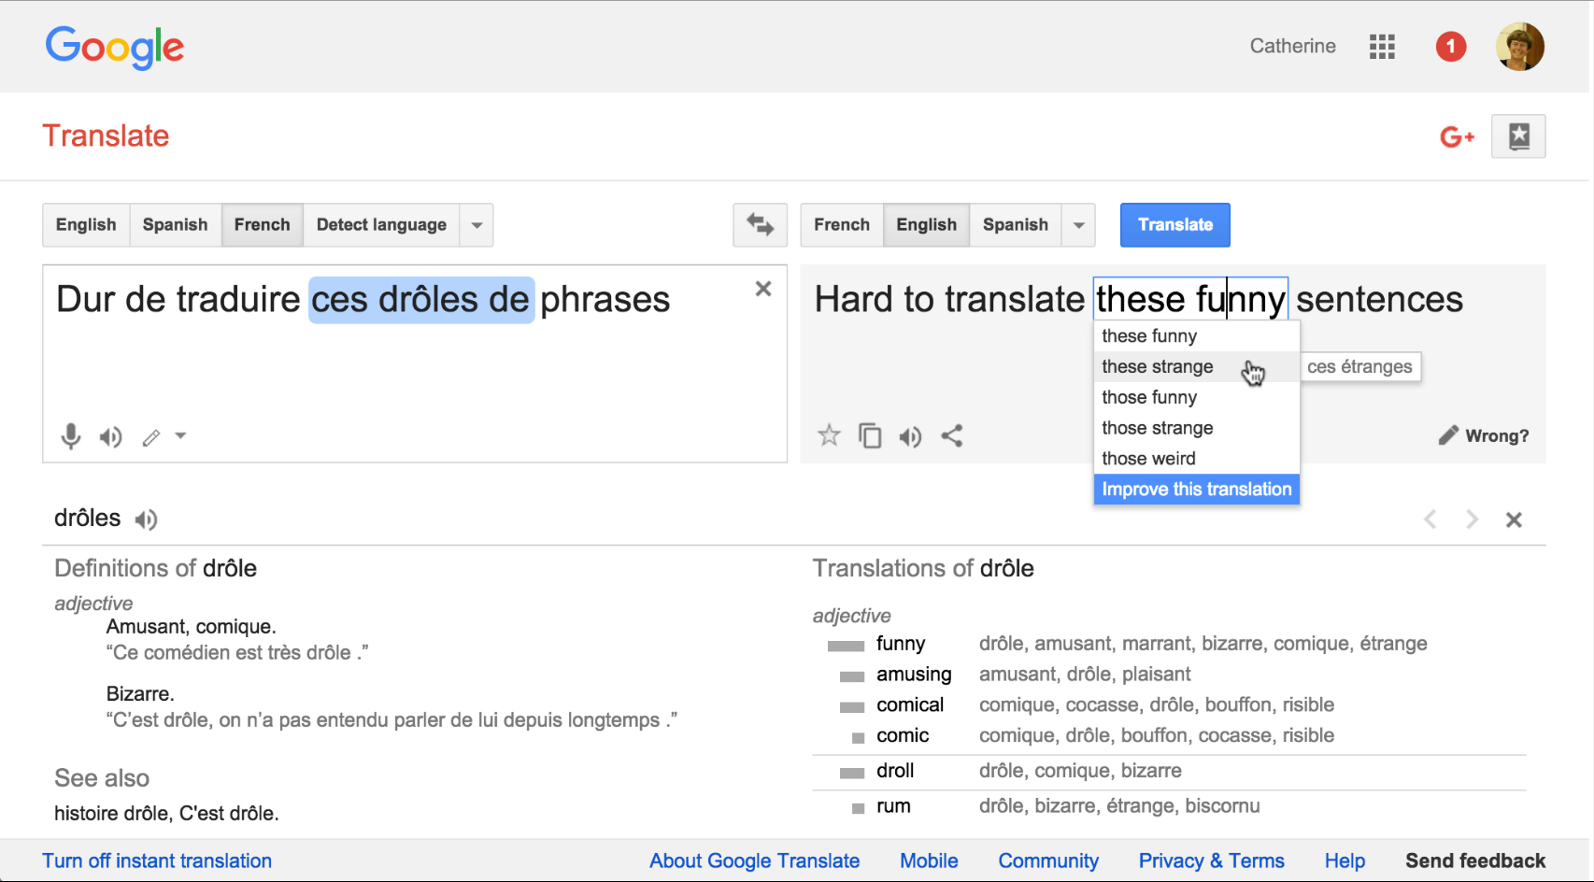
Human language technology
Google Translate, showing a French sentence translated in English

Slide 44
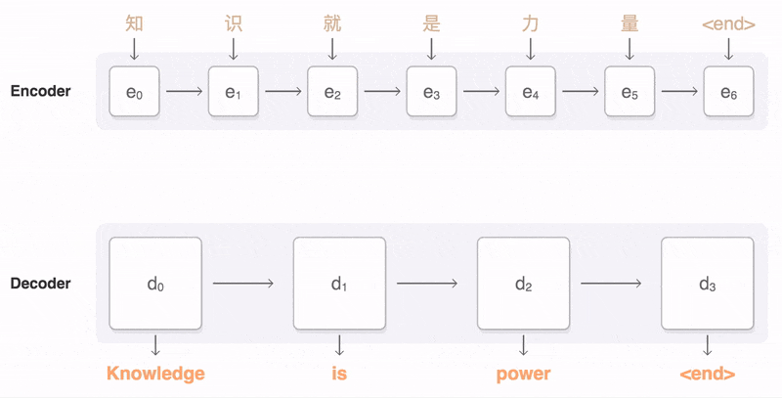
Human language technology
Google Translate
Notes:
https://labs.eleks.com/2019/06/neural-machine-translation-attention-mechanism.html

Slide 45
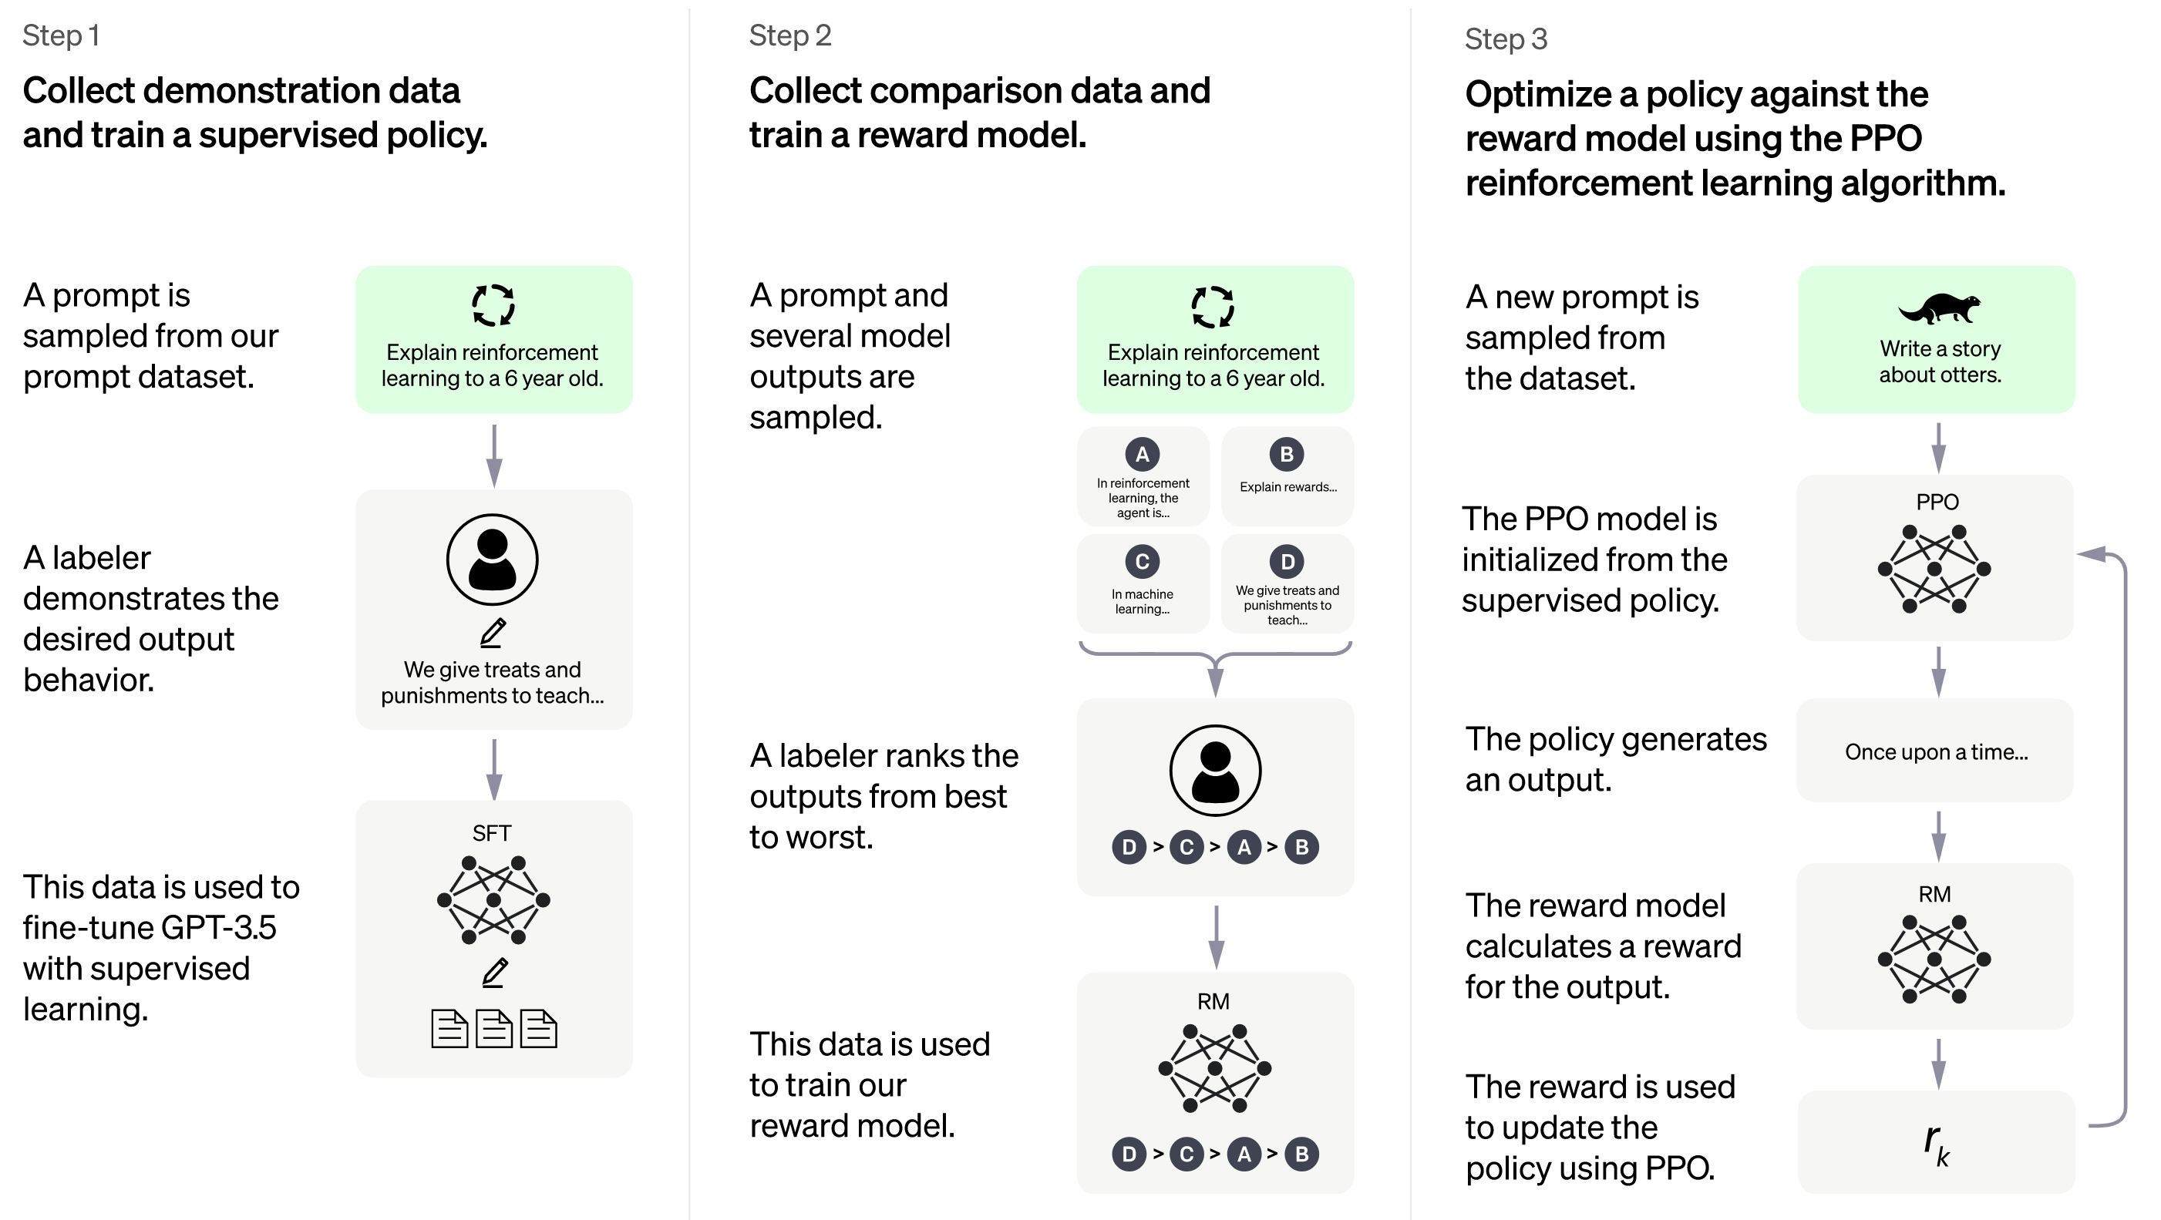


Human language technology
Chatgpt
Notes:
https://openai.com/blog/chatgpt

Slide 46
Outline
Introduction
Speech recognition
Speech production
Human language technology
Traditional command languages

Slide 47
Command Languages
Command languages are often preferred by expert users who do not want to drag and drop items for repeated steps.
A command language example is the Unix command used to delete blank lines from a file
  grep -v ^$ filea > fileb
Casual users favor GUIs but both styles of interface can be made available successfully
Other examples that behave like command languages:
  Web addresses (URLs) can be seen as a form of command language
  Twitter addresses
  Database query languages
Notes:
https://www.google.com.au/search?q=machine+translation+model&tbm=isch&ved=2ahUKEwiyh6m-yPH9AhWz9XMBHbiGAv8Q2-cCegQIABAA&oq=machine+translation&gs_lcp=CgNpbWcQARgCMgQIABBDMgQIABBDMgUIABCABDIFCAAQgAQyBQgAEIAEMgUIABCABDIFCAAQgAQyBQgAEIAEMgUIABCABDIFCAAQgARQAFgAYLQRaABwAHgAgAHOA4gBzgOSAQM0LTGYAQCqAQtnd3Mtd2l6LWltZ8ABAQ&sclient=img&ei=xQQcZPKQDbPrz7sPuI2K-A8&bih=556&biw=1067&hl=en#imgrc=OYx7URUAmhfMyM&imgdii=GsT7ZSwdNj76gM

Slide 48
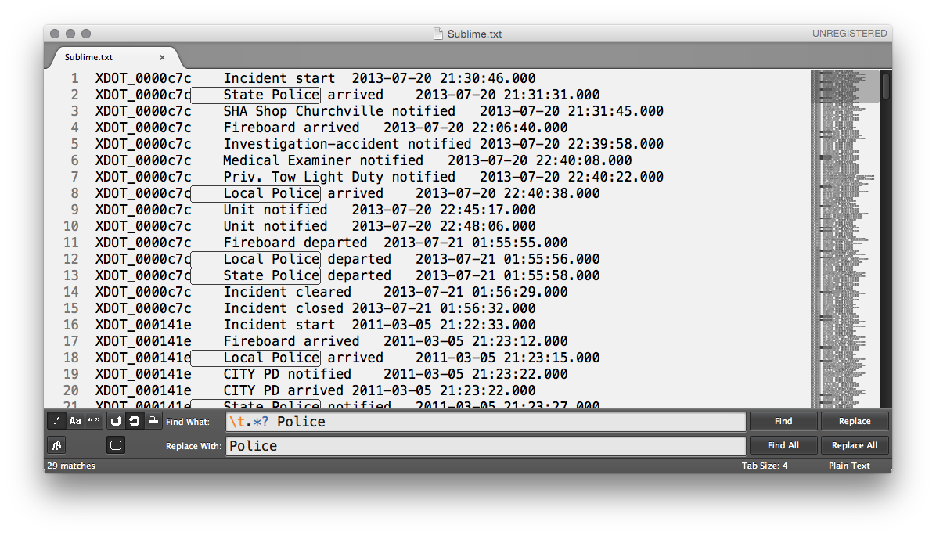
Command Languages
Using the Sublime text editor a user is doing a search and replace in a data table using regular expressions
  Typing “ \t.*? Police” in the search box searches for a tab followed by zero or more character, a space, and then by “Police”
  The patterns found in the document are highlighted with a thin black line in the document, showing that both “local police” and “state police” have been found and selected
  An overview of the entire document is visible on the right, revealing the presence of many other matches that can now be replaced all at once.

